Slide 1
Introduction to the Aztecs
Exploring the Ancient Civilization of the Aztecs

Slide 2
Who were the Aztecs?
The Aztecs were a Mesoamerican civilization that flourished from the 14th to the 16th century.
They were known for their advanced agricultural practices, impressive city-states, and complex social and political structures.
The Aztecs built a powerful empire in central Mexico and were renowned for their art, architecture, and religious rituals.

Slide 3
City of Tenochtitlan
Tenochtitlan was the capital city of the Aztec Empire.
Located on an island, it was a marvel of engineering with canals, causeways, and impressive pyramids.
The city was a center of trade, culture, and religion, attracting visitors from far and wide.

Slide 4
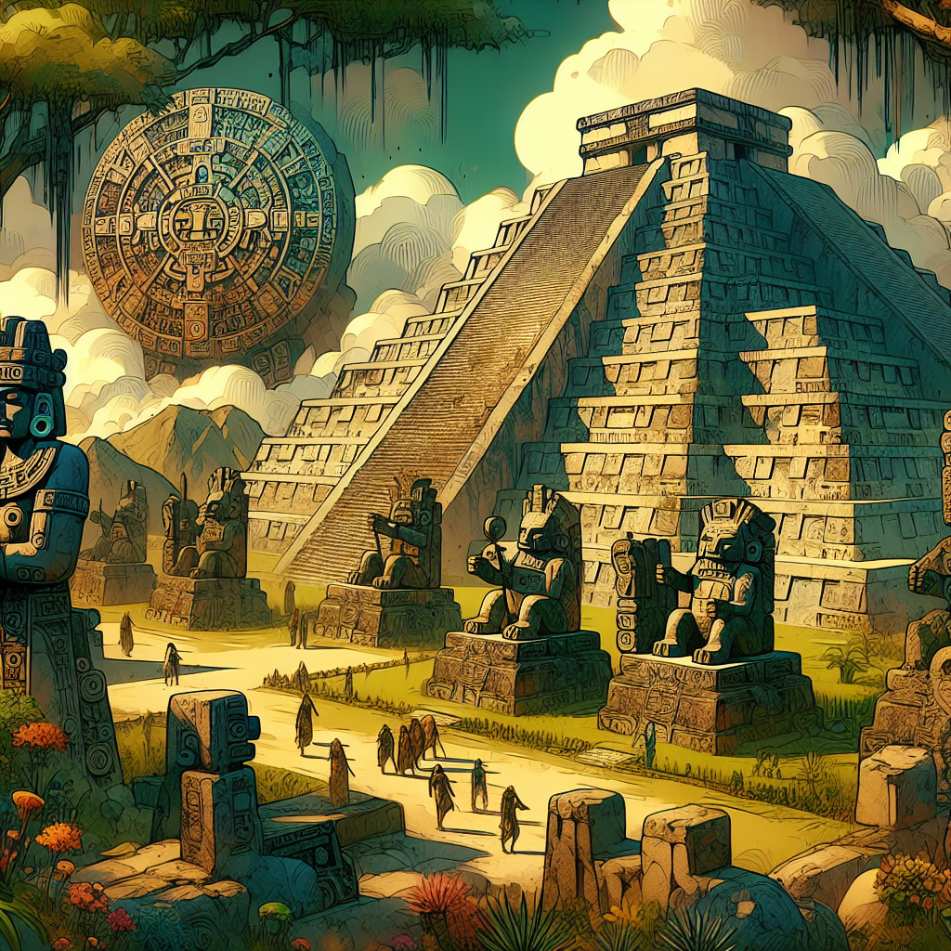
Aztec Art and Architecture
Aztec art and architecture showcased the creativity and skill of the civilization.
They created intricate sculptures, colorful murals, and impressive pyramids.
These works of art often depicted gods, warriors, and scenes from everyday life.
Aztec Pyramid

Slide 5
Aztec Religion and Mythology
Religion played a central role in Aztec culture.
They worshipped a pantheon of gods and goddesses, with Huitzilopochtli as the chief deity.
The Aztecs believed in human sacrifice as a way to appease the gods and ensure the continuation of the world.

Slide 6
Aztec Daily Life
The Aztecs had a complex social structure with emperors, nobles, warriors, and commoners.
They were skilled farmers, growing crops such as maize, beans, and squash.
Aztec society was also known for its vibrant marketplaces and elaborate festivals.

Slide 7
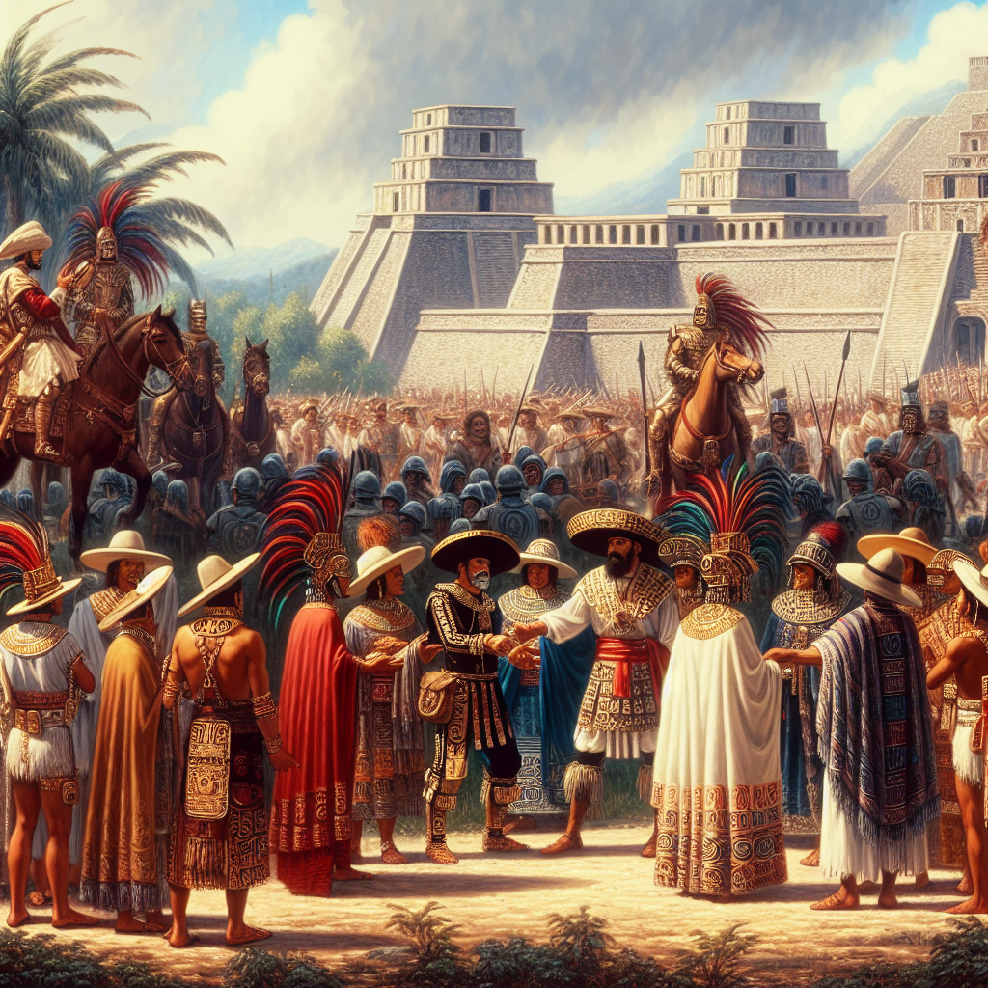
Spanish Conquest
The Aztec Empire was eventually conquered by the Spanish led by Hernan Cortes.
The conquest marked the end of the Aztec civilization and the beginning of Spanish colonization in the region.
The Spanish brought diseases, imposed their religion, and exploited the resources of the conquered lands.
Spanish Conquest

Slide 8
Legacy of the Aztecs
Despite the Spanish conquest, the influence of the Aztec civilization can still be seen today.
Their art, architecture, and agricultural practices continue to inspire and captivate people around the world.
The Aztecs left behind a rich cultural legacy that is celebrated and studied to this day.

Slide 9
References
1. Smith, M. E. (2012). The Aztecs. John Wiley & Sons.
2. Carrasco, D. (2000). Daily life of the Aztecs: People of the sun and earth. Greenwood Publishing Group.
3. Townsend, R. F. (2003). The Aztecs. Routledge.

Slide 10
Thank You
Thank you for your attention!
Any questions?

